Slide 1

Under the guidance of Mr. B. Srikanth Assistant Professor, Dept. of ECE
VARDHAMAN COLLEGE OF ENGINEERING, HYDERABAD
Autonomous institute, affiliated to JNTUH
RFID Based contactless Attendance Management System and Students Monitoring System.
21885A0419 B. Harshath kumar
21885A0420 C. Vinathi
21885A0421 K. Sai Nandini
21885A0422 K. Mahesh
21885A0423 V. Aakash chandra
21885A0424 V. Aashritha raj

Slide 2

Problems of current attendance system
Roll call in educational institutions and offices consumes considerable amount is time and resources.
Schools or colleges can overcome this inefficiency and address the problem adopting RFID based attendance.

Slide 3
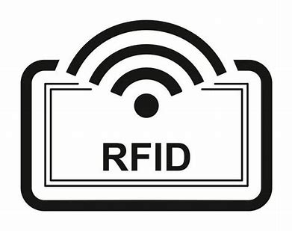
What is RFID based attendance system with SMS alert?
Radio Frequency Identification
RFID tag serves as a unique identification card for every individual student.
RFID makes the attendance process simple.
As soon as the student enter the college premises the attendance marks automatically and sends sms alerts.

Slide 4
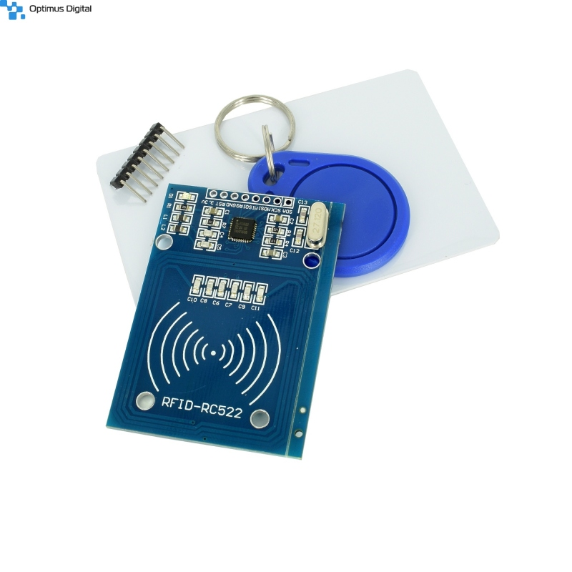
Features of RFID attendance system with SMS alerts :
Capability to store maximum records in real time.
Maximum reading range.
Auto attendance
SMS alerts with timings of Enter and Exit.
Keeping records of late arrival and early departure.
It is contact less process

Slide 5
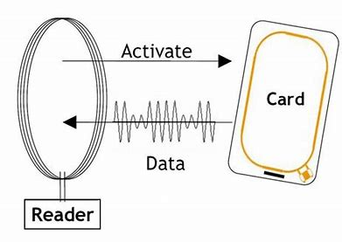
Working principle
Radio Frequency Identification(MFRC 522)
The reader coil generates an electromagnetic fields, which couples into the coil on the RFID tag.
The field generates a current in the transponder, which powers it, and also contains the transmitted data.
Tag extracts the power and transmits the message.

Slide 6

Advantages of using RFID :
→Hard copy paper work can be reduced.
Data can be stored for lifetime period
No Human power included.
Limitations :
→One person can give another person attendance using others tags

Slide 7
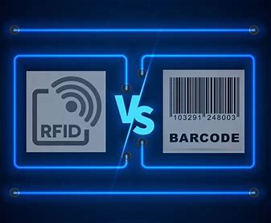
RFID advantages over BAR Codes
No manually pass item over scanner
More accurate
Time saving process
No human effort
No heavy software required
Less power consumption
RFID remains for lifetime

Slide 8
Components used:
MFRC – 522 RFID RF IC card sensor module
RFID tags
Atmega328p
RPS[Regulated power supply]
Type B Connector Cable
Personal computer
Gsm sim 900A
ESP82366 ( optional for IOT )

Slide 9
GSM (GLOBAL SYSTEM FOR MOBILE COMMUNICATION)
Global System for Mobile (GSM) is a second generation cellular standard developed to cater voice services and data delivery using digital modulation
Developed by Group Special Mobile (founded 1982) which was an initiative of CEPT ( Conference of European Post and Telecom )
GSM have 124 duplex channels, each 200Khz wide, are used for FDMA.
GSM 900 Mobile to BTS (uplink): 890-915 Mhz BTS to Mobile(downlink):935-960 Mhz

Slide 10
Subscriber Identity Module (SIM)
• Smart card contains the International Mobile Subscriber Identity (IMSI)
• Allows user to send and receive calls and receive other subscribed services
• Encoded network identification details - Key Ki, Kc and A3,A5 and A8 algorithms
• Protected by a password or PIN
• Can be moved from phone to phone – contains key information to activate the phone

Slide 11
Base Station Subsystem (BSS)
Base Station Subsystem is composed of two parts that communicate across the standardized Abis interface allowing operation between components made by different suppliers
1. Base Transceiver Station (BTS)
2. Base Station Controller (BSC)

Slide 12
Base Station Controller (BSC)
Manages Radio resources for BTS
Assigns Frequency and time slots for all MS‘s in its area
Handles call set up
Transcoding and rate adaptation functionality
Handover for each MS
Radio Power control
It communicates with MSC and BTS

Slide 13
Network Switching Subsystem(NSS)
Mobile Switching Center (MSC)
Heart of the network
Manages communication between GSM and other networks
Call setup function and basic switching
Call routing
Billing information and collection
Mobility management - Registration - Location Updating - Inter BSS and inter MSC call handoff
MSC does gateway function while its customer roams to other network by using HLR/VLR

Slide 14
Home Location Registers (HLR)
permanent database about mobile subscribers in a large service area(generally one per GSM network operator)
database contains IMSI, MSISDN, prepaid/postpaid, roaming restrictions, supplementary services.
Visitor Location Registers (VLR)
Temporary database which updates whenever new MS enters its area, by HLR database - Controls those mobiles roaming in its area
Reduces number of queries to HLR - Database contains IMSI, TMSI, MSISDN, MSRN, Location Area, authentication key

Slide 15
OTHER APPLICATIONS
College Bus access control on bus fee payment
Security system
Contact less Door lock
Sports inventory management

Slide 16
Future scopes
We can update it to IOT based.
we can use it for library books management system.

Slide 17
THANK YOU

